Slide 1

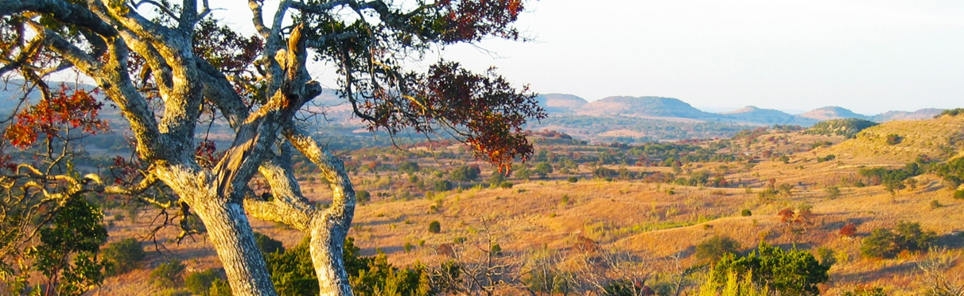
Land Trusts & Conservation
January 28, 2016
Lori Olson
Executive Director, Texas Land Trust Council

Slide 2


Mission: To encourage excellence in the Texas land trust community through collaboration, education and outreach.
Programs: Advocacy, Education & Training, Technical Resources & Assistance (for land trusts and landowners).
Goals: To promote, advance and sustain the greater statewide land trust community, so that they are prepared to deliver on the promise of conservation in perpetuity.

Slide 4
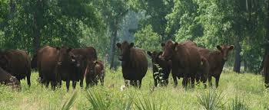
Why is Private Lands Conservation Important in Texas?
~ 95% of land in Texas is privately owned
Private lands MUST play a role in conservation in Texas
Provides a way to reduce fragmentation and keep farms and ranches intact, preserve those wide, open spaces…
Multiple public benefits derived from conserving these lands: habitat, watershed function and agriculture
TFRLCP offers needed financial incentives to landowners who engage in voluntary conservation for public benefit

Slide 5

What is a Land Trust?
A land trust is a local, state or regional nonprofit organization that protects land for its natural, recreational, scenic, historic or productive value.
History of land trusts in the U.S. goes back over 120 years, but most explosive growth has been over the last 25+/- years.
Land trusts can be local, regional, statewide, national or worldwide, with a wide variety of conservation missions. (wildlife, agricultural, open space, scenic)

Slide 6
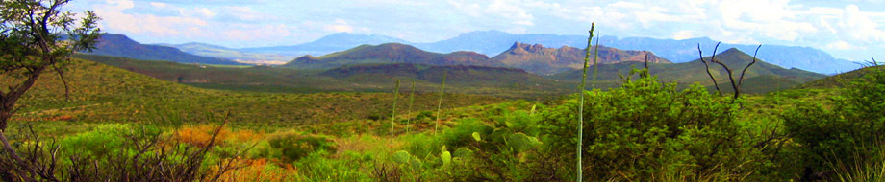
Conservation Easements
Voluntary conservation agreements negotiated between a property owner and a easement holder (land trust) to protect recognized conservation values.
  Conservation easements legally restrict development rights (generally in perpetuity).
  Keep ownership and management costs in private hands.
  More cost-effective (than fee-simple conservation) to protect larger landscapes or agricultural resources.

Slide 7

What is the Land Trust Role?
To work in partnership with landowner (and other partners) to permanently protect the land:
Negotiate the conservation easement with the landowner to protect conservation values
Document baseline features of property
Conduct regular (usually annual) visits to the property for easement stewardship
Enforce permanent protection, when necessary

Slide 8

National Perspective
1,700 Land Trusts across U.S.A.
50 million acres preserved
(area 1/3 the size of Texas)
100,000 volunteers and 5 million members
National Association:
Formed in 1981
Focus on Advancing Pace, Quality, and Permanence of land trust work

Slide 9
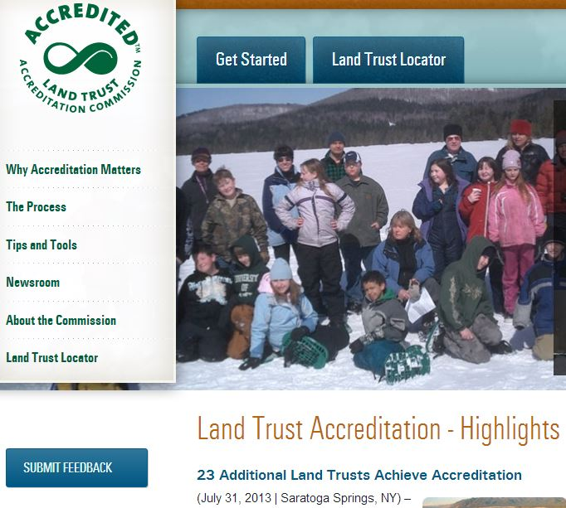
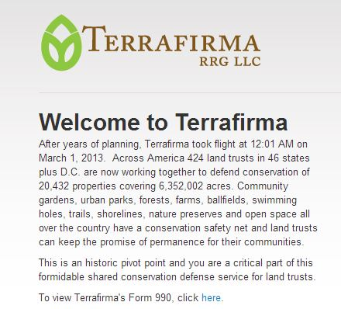
National Programs

Slide 10
Federal CE Tax Incentives
ut Congress has allowed the Enhanced Easement Incentive Act to expire, reducing the value of the tax incentive for many landowners!
Enhanced Tax Deduction for Conservation Easements
*Made a PERMANENT part of US Tax Code in Dec 2015*
Since 2006, allows federal income tax deduction for donation of conservation easement ($ value of development rights given up or portion thereof)
Allows working farmers and ranchers, as well as landowners with modest incomes, to realize more of the value of the tax deduction
Estate Tax Reduction
Possibly reduce value of land estate, which can dramatically decrease estate tax due

Slide 11
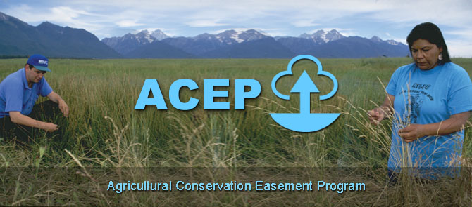
NRCS- Ag Conservation Easement Program (ACEP)
USDA- NRCS has funding through the Farm Bill to purchase Cons. Esmts. (pay up to 50% of value)
TFRLCP provides the required matching funding source to allow Texas to utilize this $
Landowner donation of up to 25% possible, for full leverage
ALE (ag lands)
&
WRE (wetlands)

Slide 12
Historic USDA- NRCS
FRPP Total Obligations by FY
(* in thousands of dollars and sq miles)
State | 2010 | 2011 | 2011 | 2012
CO (104 sq mi) | 6,581 | 8,584 | 7,322 | 16,282
OH (45 sq mi) | 4,081 | 12,132 | 8,652 | 7,066
WY (98 sq mi) | 21,093 | 53,365 | 15,780 | 6,089
MA (11 sq mi) | 8,844 | 5,681 | 9,632 | 9,165
TX (269 sq mi) | 2,110 | 2,962 | 5,696 | 4,093
2014 Farm Bill provides $1 Billion over 10 years
for conservation easements

Slide 13
2014 Farm Bill
ACEP-ALE TX Applications
*in thousands of dollars
 | 2014 | 2015 | 2016
# Appns | 2 | 4 | 10
Acres | 483 | 2590 | 16059
Funds Requested | 1,693 | 7,275 | 9,017
# Appns Funded | 2 | 2 | ?
Funding Received | 1,693 | 4,505 | $$$$$$
2016 is poised to see an increase in federal funding to TX and TFRLCP is a BIG reason why!

Slide 14
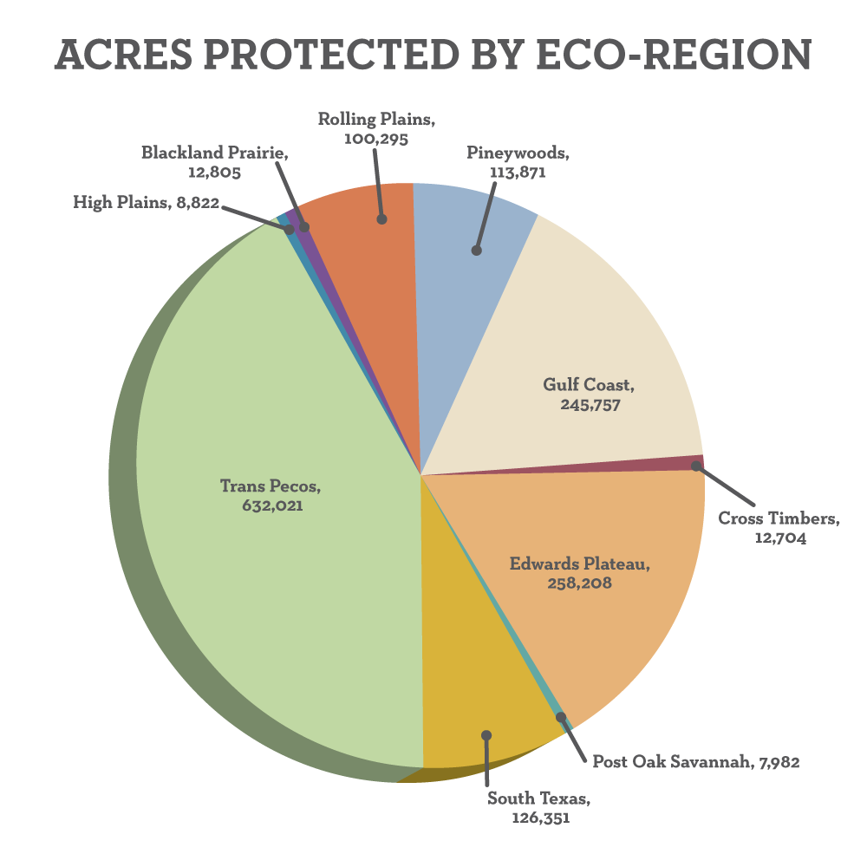
Texas Perspective
Over 30 Land Trusts across our state
Vary from several staff to all volunteer
More than 33,000 members and growing!

Slide 15
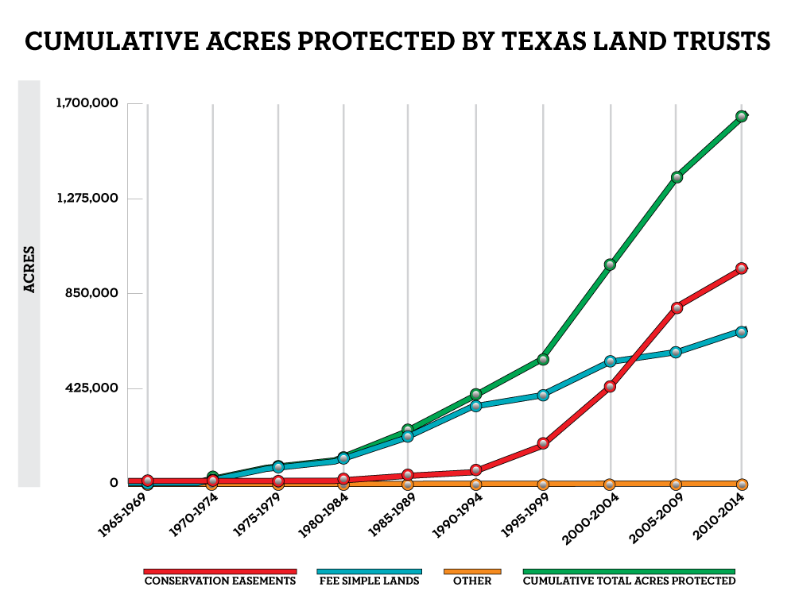
Over 1.6 Million Acres Conserved !!

Slide 16
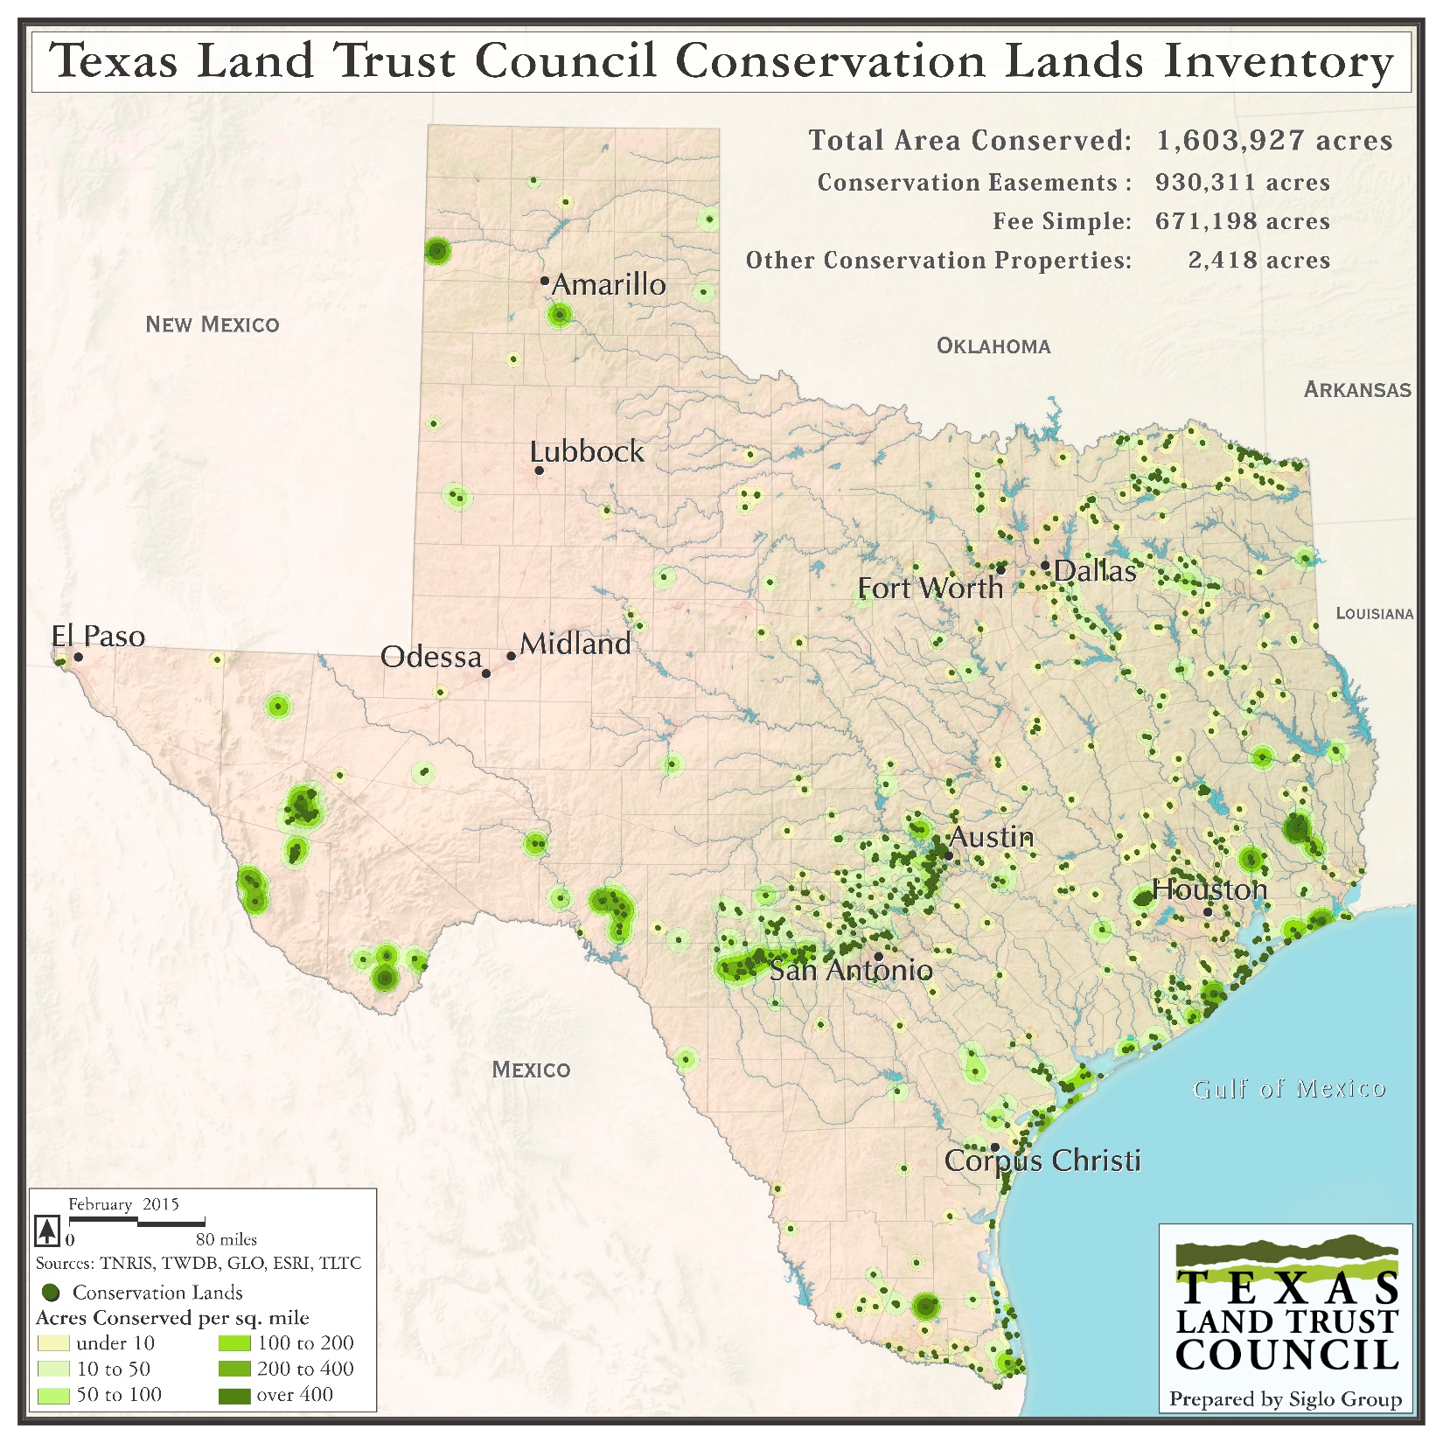

Slide 17
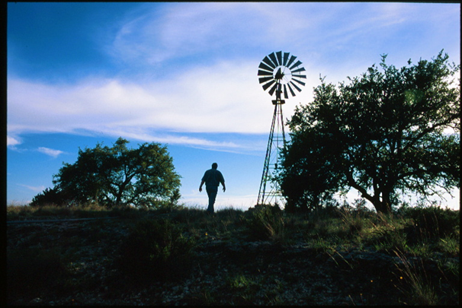
Questions?
lori@texaslandtrustcouncil.org
www.texaslandtrustcouncil.org
Thank you!

